Slide 1
Micro services By Narayana & Adithya

Slide 2
What is Monolithic?
“Monolithic” means composed all in one piece. Monolithic software is designed to be self-contained; components of the program are interconnected and interdependent rather than loosely coupled as is the case with modular software programs. In a tightly-coupled architecture, each component and its associated components must be present in order for code to be executed or compiled.
What is Microservices?
Microservices - also known as the micro service architecture - is an architectural style that structures an application as a collection of services that are
Highly maintainable and testable
Loosely coupled
Independently deployable
Organized around business capabilities.
The micro service architecture enables the continuous delivery/deployment of large, complex applications. It also enables an organization to evolve its technology stack.

Slide 3
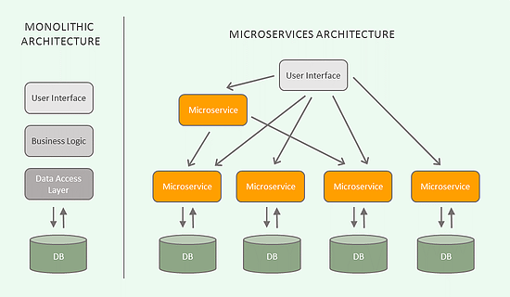
Monolithic Vs Microservice

Slide 4
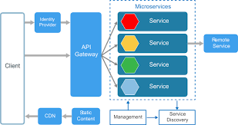
What is a Microservices Architecture?

Slide 5
Microservices Pros and Cons:
Pros
Micro service architecture gives developers the freedom to independently develop and deploy services
Code for different services can be written in different languages (though many practitioners discourage it)
Easy integration and automatic deployment (using open-source continuous integration tools such as Jenkins, Hudson, etc.)
Easy to understand and modify for developers, thus can help a new team member become productive quickly.
The developers can make use of the latest technologies
The code is organized around business capabilities
Starts the web container more quickly, so the deployment is also faster
When change is required in a certain part of the application, only the related service can be modified and redeployed—no need to modify and redeploy the entire application

Slide 6
Better fault isolation: if one micro service fails, the other will continue to work (although one problematic area of a monolith application can jeopardize the entire system)
Cons:
Due to distributed deployment, testing can become complicated and tedious.
The architecture brings additional complexity as the developers have to mitigate fault tolerance, network latency, and deal with a variety of message formats as well as load balancing.
Being a distributed system, it can result in duplication of effort.
When number of services increases, integration and managing whole products can become complicated.

Slide 7
Service Registry
Eureka
Service-1
DB
Service-2
DB
API Gateway(ZUUL)
Client
Service-3
DB
Service-4
DB

Slide 8
Why do we need API Gateway?
API Gateway, aka Edge Service, provides a unified interface for a set of microservices so that clients no need to know about all the details of microservices internals. However, there are some pros and cons of using API Gateway pattern in microservices architecture.
Pros:
Provides easier interface to clients
Can be used to prevent exposing the internal microservices structure to clients
Allows to re-factor microservices without forcing the clients to re-factor consuming logic
Can centralize cross-cutting concerns like security, monitoring, rate limiting etc.

Slide 9
Cons:
It could become a single point of failure if proper measures are not taken to make it highly available

Slide 10

Zuul Routing

Slide 11
Routing
> One URL to the outside
> Internal: Many Microservices
> In particular: REST
> Power through filters

Slide 12





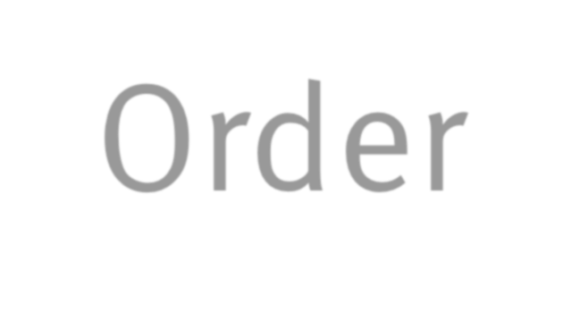

Automatically maps route to server registered on Eureka
i.e. /customer/**
Zuul Proxy
to CUSTOMER
No configuration
Can add filters etc
Customer
Order
Catalog

Slide 13



Zuul Proxy
@SpringBootApplication
@EnableZuulProxy
Enable Zuul Proxy
public class ZuulApplication {
public static void main(String[] args) {
new SpringApplicationBuilder(ZuulApplication.class). web(true).run(args);
}
}
Can change route
Also routing to external services possible

Slide 14
Spring Cloud Config

Slide 15
Configuration
> Spring Cloud Config
> Central configuration
> Dynamic updates
> Can use git backend

Slide 16



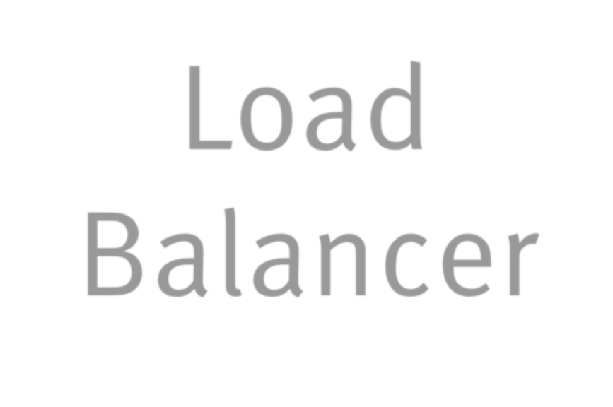

Proxy Load Balancing
Server
Client
Load
Balancer
> Centralized Load Balancing
> Can become bottle neck
> Single point of failure
> Configuration complex

Slide 17

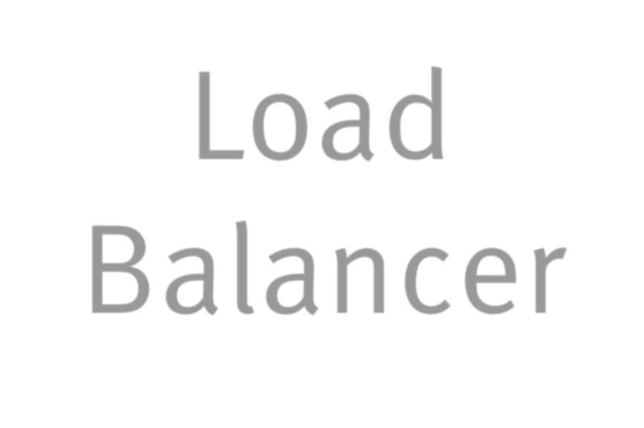



Ribbon: Client Side Load Balancing
Server
Load
Balancer
Client
> Decentralized Load Balancing
> No bottle neck
> Resilient
> Can consider response time

Slide 18
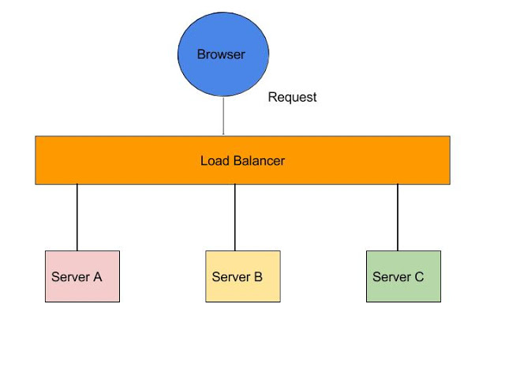
Ribbon

Slide 19










RestTemplate & Load
Balancing
Enable Ribbon
@RibbonClient(name = "ribbonApp")
…
Left out other annotations
public class RibbonApp {
@Autowired
private RestTemplate restTemplate; public void callMicroService() {
Standard Spring REST client
Store store = restTemplate.
Can also use Ribbon API
getForObject("http://stores/store/1", Store.class);
}
Eureka name or server list
}

Slide 20

Service Discovery Eureka

Slide 21
What is Eureka?
In simple word Eureka is a service Registry or we can say it is an embedded server provided by Netflix third party which integrate with spring framework.
Main purpose to use Eureka : Micro service Registration and Discovery with Spring Cloud and Netflix's Eureka
What is the use of Eureka?
http://localhost:8083/service3/payment
http://serviceName/service3/payment
Instead of using IP address and port no we can use service name

Slide 22
Why Eureka?
> REST based service registry
> Supports replication
> Resilient
> Fast
> Foundation for other services

Slide 23
Eureka Client in
Spring Cloud
> @EnableDiscoveryClient: generic
> @EnableEurekaClient: more specific
> Dependency to
spring-cloud-starter-eureka
> Automatically registers application

Slide 24










application.properties
Eureka server
Can include user / password
eureka.client.serviceUrl.defaultZone=http://host:8761/eureka/
Faster updates
eureka.instance.leaseRenewalIntervalInSeconds=5
spring.application.name=catalog
Used for registration
In CAPITAL caps
eureka.instance.metadataMap.instanceId=${spring.application.name}:${r andom.value}
eureka.instance.preferIpAddress=true
Docker won’t resolve host names
Need unique ID Load balancing

Slide 25


Eureka Server
@EnableEurekaServer
@EnableAutoConfiguration
public class EurekaApplication {
public static void main(String[] args) {
SpringApplication.run(EurekaApplication.class, args);
}
}
Add dependency to
spring-cloud-starter-eureka-server

Slide 26
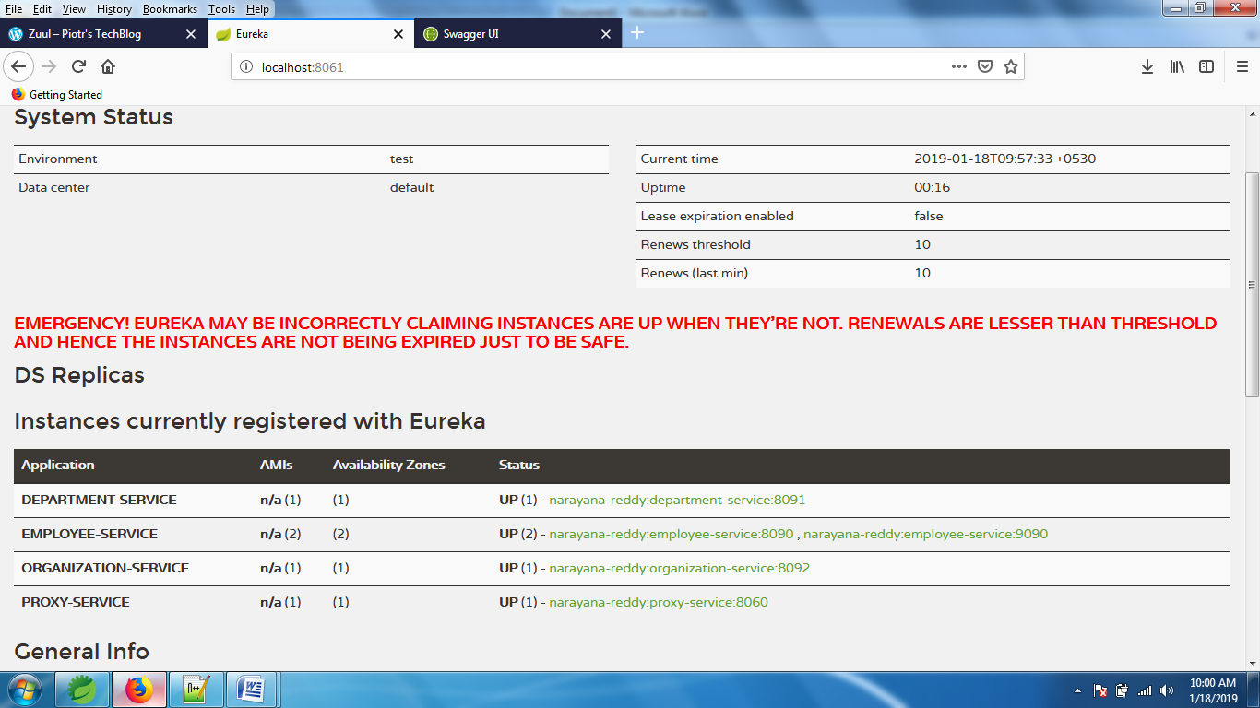

Slide 27
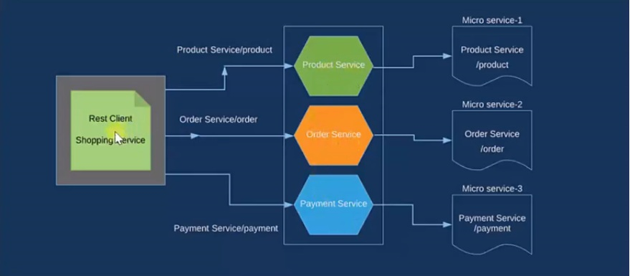
Eureka Architectural diagram:

Slide 28
Hystrix(Fault Tolerance)

Slide 29
Hystrix
> Enable resilient applications
> Won’t block request handler
> Can implement timeout
> Monitor using Hystrix Dashboard

Slide 30

Hystrix
> Circuit Breaker
> If call system fail open
> If open do not forward call
> Forward calls after a time window
> System won’t be swamped with requests

Slide 31


Fallback
@HystrixCommand(fallbackMethod = "getItemsCache")
public Collection<Item> findAll() {
…
this.itemsCache = pagedResources.getContent(); return itemsCache;
}
private Collection<Item> getItemsCache() {
return itemsCache;
}

Slide 32
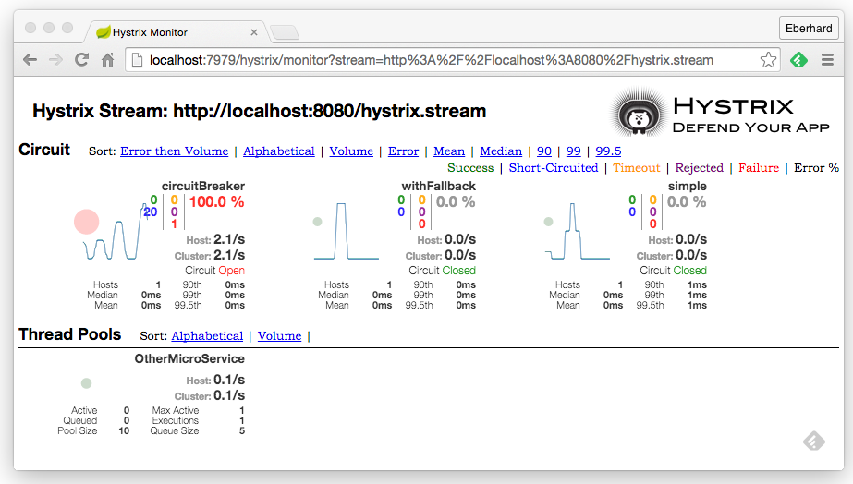






Stream via http
Circuit Breaker status
Thread Pool status

Slide 33
Techstack and Infrastructure
> Easy to create a new project(Spring boot)
> REST integrated
> Messaging supported
> Simple deployment
> Uniform operations
> Using cloud providers for IAAS(Amazon, pivotal, etc…)

Slide 34
Spring Cloud
> Eureka: Service Discovery
> Zuul: Route calls to a service
> Spring Cloud Config: Configuration
> Ribbon: Load Balancing
> Hystrix: Resilience

Slide 35
THANK YOU

